Slide 1
Flight Opportunities (FO)
Technology Summary Chart
The purpose of the Summary Chart is to capture the top-level, critical information for the project on a single, stand-alone page. The Summary Chart shall occupy the entire 8.5” x 11” page and be in landscape format. The Summary Chart will be used for NASA internal presentations and may also be released publicly. Proprietary and/or ITAR information must NOT be included and all information on the chart must be publicly releasable by NASA. The Summary Chart may be edited for formatting and uniformity by NASA.
The Summary Chart shall use the PowerPoint format as provided in the figure. The titles and layout of each block must not be changed. The size of each text block may be adjusted as needed. The information must be consistent with the information provided in the complete proposal and in the Proposal Cover Page. The text in each block may be provided in sentence or "bullet-point" format. A minimum text size of 10 point is required. The specific instructions for each block are given below.
Block 1 - Technology Title
Provide the complete technology title.
Block 2 - Technology Need
Describe the current state of the art and need(s) for advancement. A statement as to the technology relevance and how the proposed technology will advance the state of the art should be included.
Block 3 - Technology Concept
Describe the overall concept of the proposed technology and its purpose. This must not include proprietary and/or ITAR/EAR information.
Block 4 - Technology Development Team
Provide the name and the organizational title of the Principal Investigator.
Block 5 - Test Apparatus
Provide a brief description of the planned payload flight apparatus. This should include the overall size and weight as well as any special interface and operational requirements. Special hazards or safety issues should be identified.
Block 6 - Graphic
A photo and/or a functional schematic of the test apparatus must be provided.
Block 7 - Flight Requirements/Objectives
Outline the overall flight test plan and identify the desired flight vehicle type. The specific technical objectives for each flight and any special flight requirements should be defined. The flight readiness date should be included.
Block 8 - Technology Advancement
Include specific statements as to exactly how a successful flight test program will advance the state of the art. Identify the anticipated TRL following completion of the flight test.
Block 9 - Technology End Users
Identify users and applications of the proposed technology once it has been sufficiently developed. This could include NASA and other government flight programs as well as commercial flight and Earth applications.
Block 10 - Technology Applicability
Specify the primary technology applicability addressed by your proposal. Statements should be brief, but comprehensive. For example, Lunar Lander Navigation System or Cryogenic Storage Thermal Control.
Block 11 – Date
Provide the current date.

Slide 2
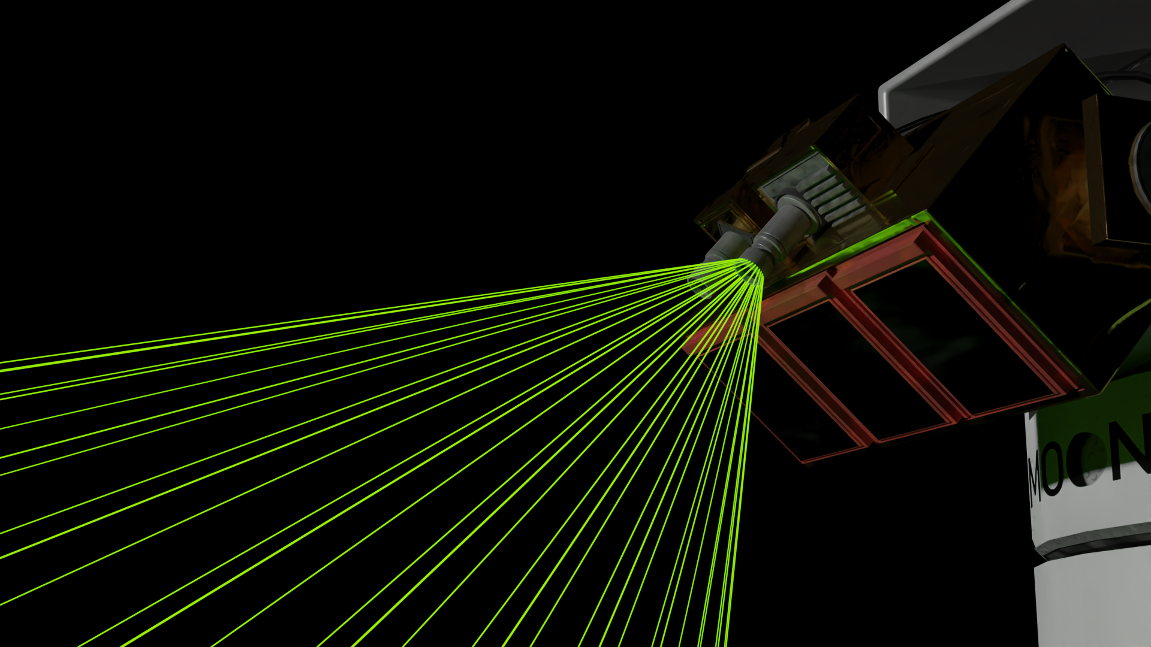
MoonFALL- Moon Fast and Accurate Lidar Localization
Technology Need
Test Apparatus
Flight Requirements/Objectives
Challenging lighting and steep topography create ice-bearing regions on the Moon. The availability of smaller, less-massive hazard detection systems for landing on the Moon in low lighting conditions will lead to more spacecraft visiting these scientifically interesting and resource-rich places on the Moon.
The test payload will use lidar, RGB camera, light projector, an AI computer, power storage, and distribution systems all-embracing the SWAP-C design ideologies. Most of the components are completely COTS that will be integrated into a structural frame interface that allows for precision alignment. The hardware will be executing a software package for neural depth inferencing and mutli-sensor geometry generation and localization
Mass < 20 kg
Size < 355 mm tall x 724 mm diameter
During a nighttime suborbital test flight that simulates a lunar descent, generate a three-dimensional map of a lunar surface test field in real-time from an altitude of at least 250 meters. The map created will have a ground sample distance of < 10 cm and an elevation accuracy of < 5cm from an ideal height of 500m.
Technology Advancement
Technology Concept
Smaller and less massive systems over the state of the art are capable of detecting surface hazards in the dark on the Moon. Using readily available components combined with new approaches to software development.
The technology uses complex sensor fusion combining structured light and multiple lidar sensors. A tiered edge computing process allows for rapid creation of continually improving point cloud 3D reconstruction of the lunar terrain.
Technology End Users
Technology Development Team
NASA missions and commercial lunar service providers as well as other landing systems that are required to operate in dark environments.
Bronco Space –ICON Lab at Cal Poly Pomona
PI: Zachary Gaines- Student Researcher
Technology Applicability: Terrain Relative Navigation, Lunar Surface Reconstruction
7-29-22

